Slide 1
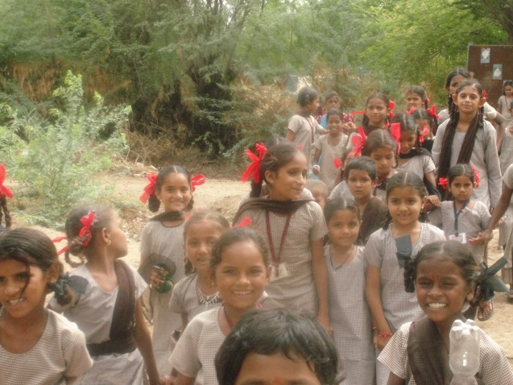
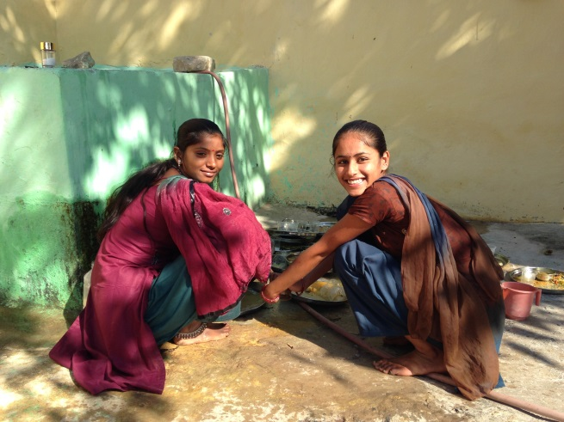
Why girls are not in school:
A review of the situation in developing countries
KG Santhya, AJ Francis Zavier, Shilpi Rampal
Population Council
Presentation made at the meeting on
“Keeping girls in secondary school: successes and challenges”
20-21st June, 2015, Dharwad

Slide 2
Educating girls offers the best hope of cutting into the cycle of female deprivation. When one takes into account all its benefits, educating girls yields a higher rate of return than any other investment available in the developing world
Lawrence H. Summers

Slide 3
International commitments to promoting girls’ education
Education for All, Dakar Framework for Action (2000)
Ensuring that by 2015 all children – particularly girls, children in difficult circumstances and those belonging to ethnic minorities – have access to complete free and compulsory primary education of good quality
Eliminating gender disparities in primary and secondary education by 2005 and achieving gender equality in education by 2015, with a focus on ensuring girls’ full and equal access to and achievement in basic education of good quality
Millennium Development Goals (2000)
MDG 2 – Achieve universal primary education- Ensure that, by 2015, children everywhere, boys and girls alike, will be able to complete a full course of primary schooling
MDG 3 – Promote gender equality and empower women - Eliminate gender disparity in primary and secondary education, preferably by 2005, and in all levels of education no later than 2015

Slide 4
How are girls faring?

Slide 5
School attendance among 10-14 year-old girls, selected countries
Most girls attend school into early adolescence
Based on analysis of DHS data

Slide 6
School attendance among 15-18 year-old girls, selected countries
The situation with older adolescent girls remains worse in many countries, with school attendance dropping by 10-45 percentage points as girls transition from early adolescence to late adolescence
Based on analysis of DHS data

Slide 7
Grade 8 completion rates for 15-18 year-old girls, selected countries
Although girls’ attendance in primary school has increased significantly, primary school completion rates are below 50% in many countries
Based on analysis of DHS data

Slide 8
Grade 10 completion rates for 17-18 year-old girls, selected countries
The picture is more dismal with regard to secondary school completion, although some countries have made significant strides in enabling their girls to complete secondary education
Based on analysis of DHS data

Slide 9
Gender gap (boys minus girls) in grade 8 completion rates for 15-18 year-old girls around 2000 and 2010, selected countries
Around 2000
Around 2010
Interestingly, most countries have achieved or are on the path to achieve gender parity in primary school completion; indeed, female advantage is evident in many countries of late
Based on analysis of DHS data

Slide 10
Gender gap (boys minus girls) in grade 10 completion rates for 17-18 year-old girls around 2000 and 2010, selected countries
2000
2010
Elimination of gender gap in secondary school completion was much less marked
Based on analysis of DHS data

Slide 11
Learning outcomes among adolescent students
Many adolescents – both boys and girls – are transitioning into secondary education without basic competencies
In India, only 75% of Class 8 students could read Class 2 text in their local language, 34% could correctly do a three digit by one digit division problem, and 47% could read simple sentences in English language
ASER, 2015

Slide 12
Why girls are not in school?

Slide 13
Limited physical access
% of 15-18 year-old girls who cited long distance to school and lack of transportation for dropping out from school
Girls’ enrolment and continuation are particularly sensitive to distance to school
A 4-country analysis in sub-Saharan Africa shows that attendance in secondary school among girls declined from above 40-50% when the school was located within a kilometre of distance to 10-15% as the distance to school increased to 6 plus kilometres
Based on DHS analysis; UNESCO, 2012

Slide 14
Limited economic access
% of 15-18 year-old girls who cited huge direct and indirect costs for dropping out from school
Economic circumstances of families often make it hard to send their children, particularly girls to school
At the same time, the indirect costs of schooling is huge for girls in many settings
Based on DHS analysis;

Slide 15
Poor quality schooling
% of 15-18 year-old girls who cited repetition, lack of interest and poor aspirations for dropping out from school
While failures, lack of interest and poor aspirations are individual-related reasons for dropping out, they reflect the poor quality of schooling
Based on DHS analysis

Slide 16
Early marriage and pregnancy
% of 15-18 year-old girls who cited marriage and pregnancy for dropping out from school
Each additional year of delay in the age of marriage is estimated to increase literacy by 6 percentage points In Bangladesh
Each year of early marriage is likely to reduce the probability of secondary school completion by 7 percentage points in Africa
Each year of early marriage is likely to reduce the fulfilment of the right to education goal by 3 percentage points in India
Based on DHS analysis; Field and Ambrus, 2009; Nguyen and Wodon, 2012

Slide 17
Limited engagement of parents in girls’ education
Parents do value education for their daughters
Yet, their engagement in their daughter’s education is limited; in a study in Gujarat:
The amount of time spent by mothers on their daughter’s studies was less than 2 hours in a week
About one-third of parents visited their daughter’s school in the month preceding the interview
Many parents don’t consider interacting with their children’s school important
Our duty is to send children to school, why should we visit schools?
Santhya et al., 2014

Slide 18
What works to promote girls’ secondary education?

Slide 19
Evidence on the effectiveness of approaches to promote girls’ education
Strategies | Strength of evidence
Demand-side strategies
Scholarships and stipends | Successful
Transportation and boarding | Promising
Community engagement in girls’ education | Promising
Safety policies and training; codes of conduct for teachers | Promising
Toilets and provision of sanitary supplies | Unlikely
Supply-side strategies
Creation of non-formal educational programmes | Promising
Recruitment/training of female teachers, para-teachers | Successful
Gender training for teachers | Promising
Mentoring, tutoring and peer support | Promising
Life skills/literacy/livelihoods training | Promising
Lloyd and Young, 2009

Slide 20
If we continue to leave vast sections of the people of the world outside the orbit of education, we make the world not only less just but also less secure
Amartya Sen

